Slide 1


Building a Cloud-Native AI Library Assistant
BY SONALI CHAWLA

Slide 2
The Problem
Traditional library catalogs are static and hard to navigate for casual readers seeking detailed context.
The Solution
A specialized AI Agent that provides deep insights into books, including plot, characters, and recommendations.
Core Task
Detailed Book Metadata & Contextual Retrieval in form of Questions and Answers.
Tech Stack
Orchestration: Agent Development Kit (ADK), Inference: Gemini 2.5 Flash, Hosting: Google Cloud Run (Serverless)

Slide 3
Project Results and Deployment Success
Cloud Run Link: <Link to app>
Example:
hello.
Hello! I can help you learn about the books we have in the library. What are you interested in today?
Do you know about the book Shadow and Bones?
Hello there! Yes, I certainly do know about "Shadow and Bone"!
It's a fantastic young adult fantasy adventure novel titled "Shadow and Bone"
and it was written by the talented American author, Leigh Bardugo.
It first hit the shelves on June 5, 2012, published by Macmillan Publishers.
What's really neat about this book is that it's the very first...
Awesome. How about the book The Shinning? I have heard about it so much.
Oh, you're asking about "The Shining"! That's a truly iconic one!
It's a very famous horror novel written by the renowned American
author Stephen King, and it was first published in 1977. This book ...
Can you provide 5 book titles for thriller genres that I can give a try?
Oh, absolutely! Thrillers are fantastic for keeping you on the edge of your seat.
Here are 5 popular thriller book titles that you ...

Slide 4
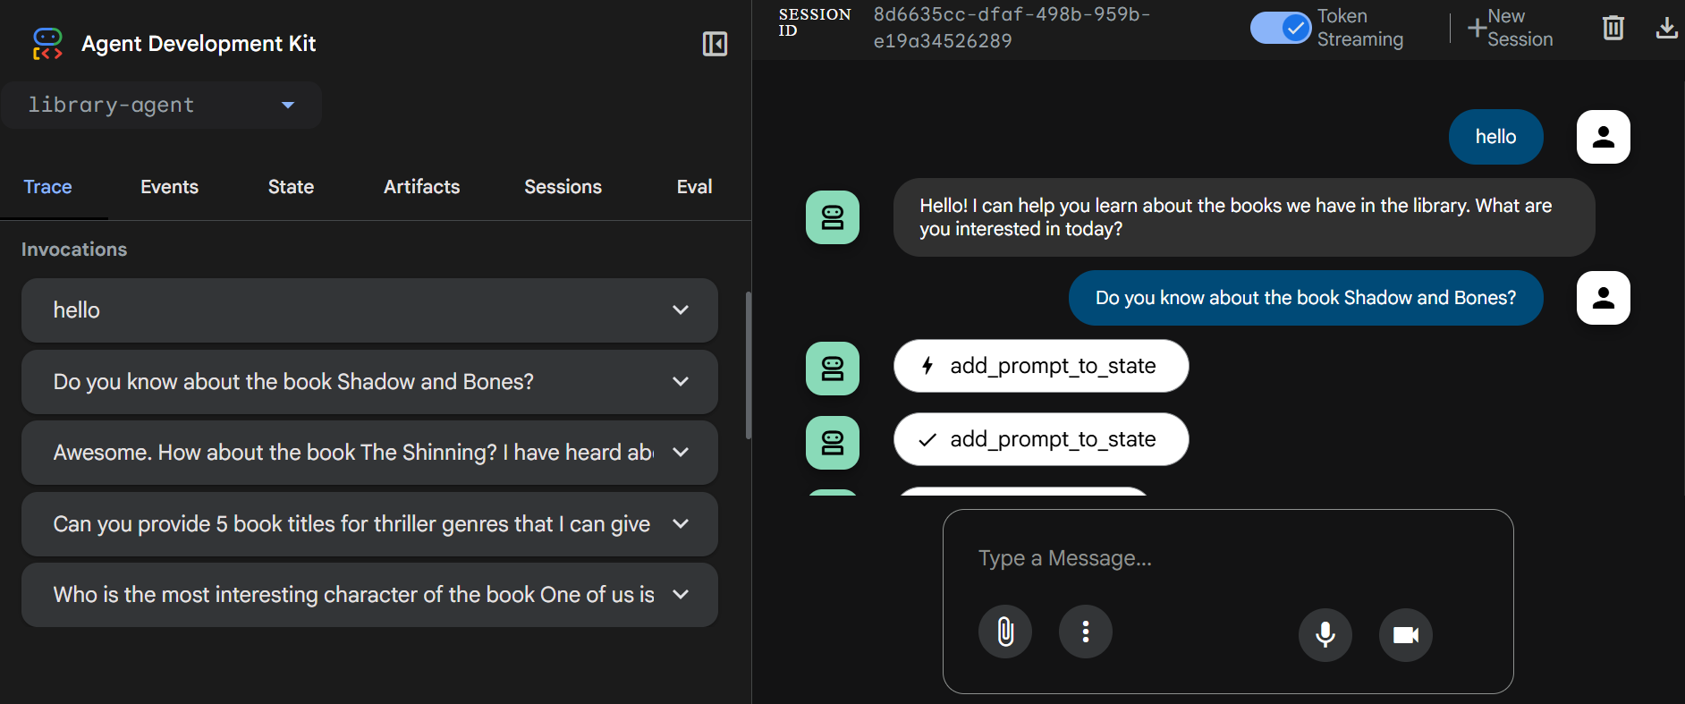
Screenshot

